Slide 1
Windows Process Injection
Demonstrated on LockDownBrowser

Slide 2
Feel free to stop me for questions!

Slide 3
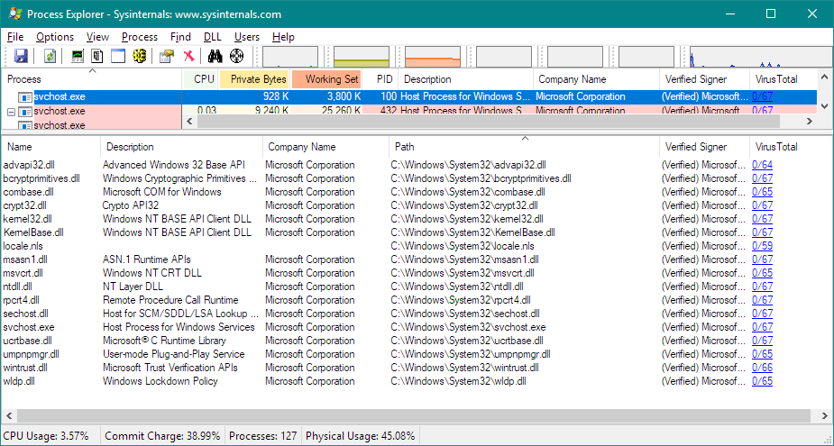
Preface – “Windows Process”

Slide 4
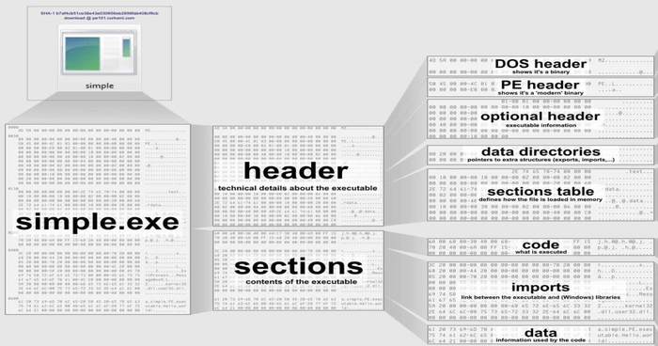
”PE” File makeup

Slide 5
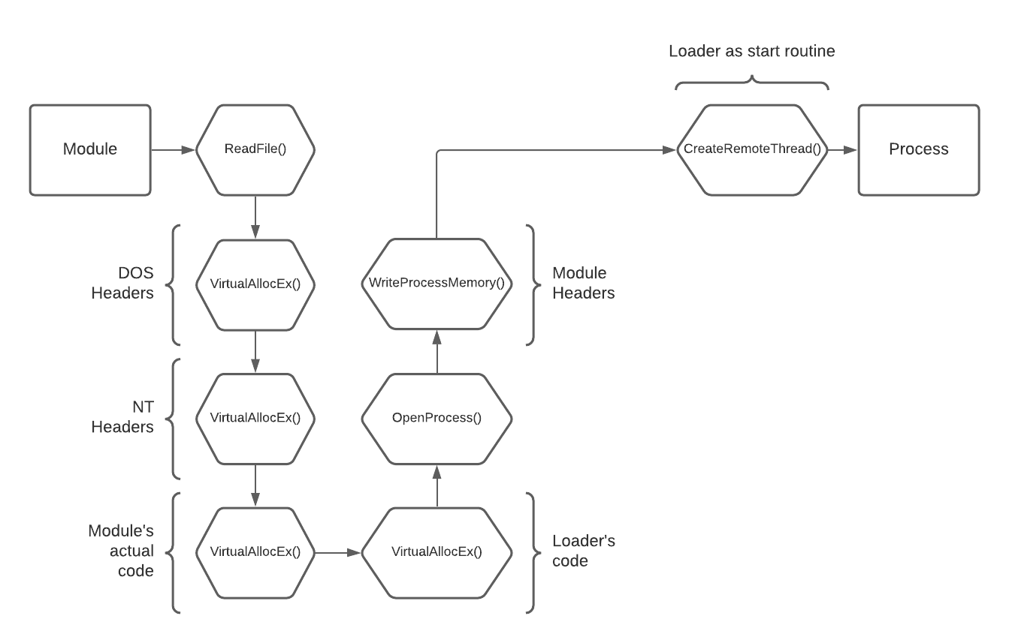
Preface – module INjection
Usually, two methods

Slide 6
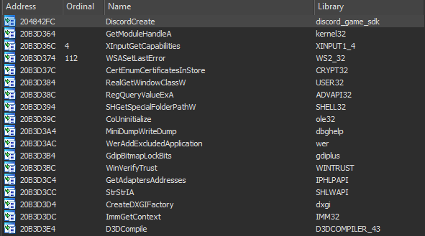
One more method
Only works in executables that ship with a library

Slide 7
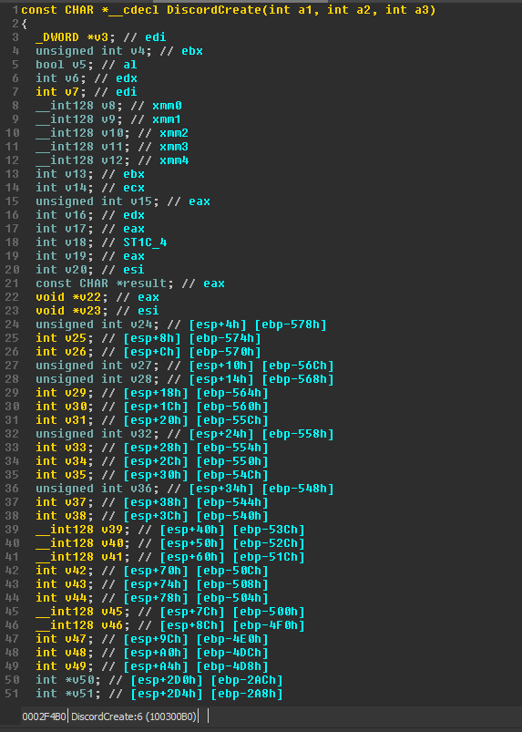
Looking further
DiscordCreate() function under the hood

Slide 8
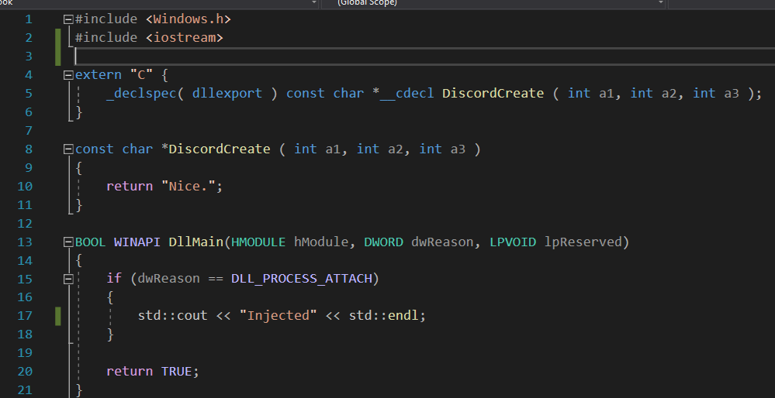
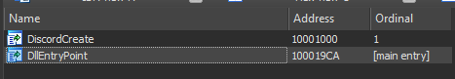
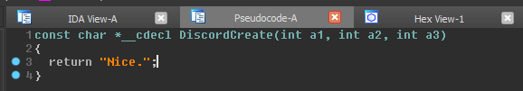
Fake export
We exported our own function called DiscordCreate() and return any const char*

Slide 9
Does this work?
Yes! A few drawbacks however:
Hash checking
Proper error handling
Replacing a required function*
The best quality if viable?
Completely undetectable

Slide 10
Lockdown browser specific
What is LockDown Browser comprised of?
Heavily modified Chromium
Tons of WINAPI function calls to disable potential bypasses (Task Manager, CMD, changing user level, etc.)
Few of low-level hardware & software hooking (what we are interested in)

Slide 11
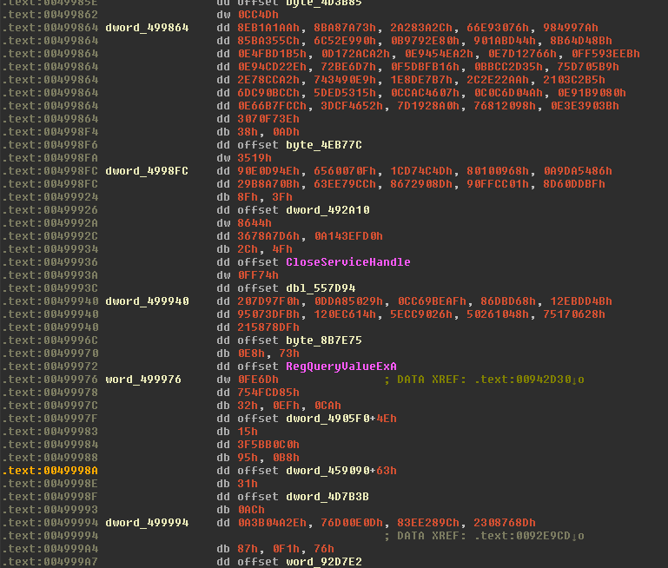
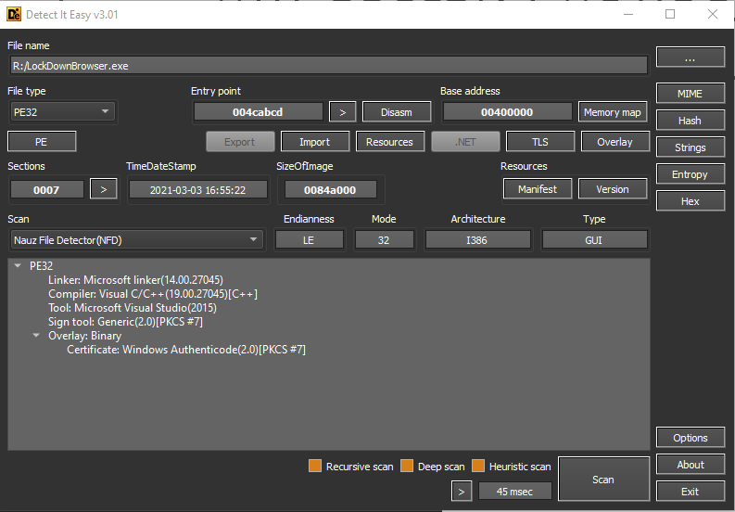
Why couldn’t we hook functions in the binary?
Certainly, an option but…

Slide 12
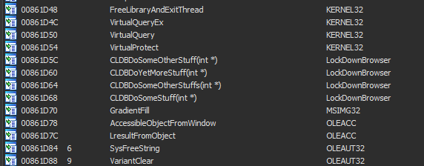
Lockdown browser imports
OwO what’s this?

Slide 13
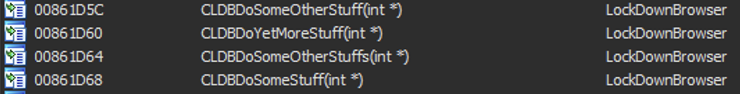
Strange function names?
Address*
Function Name
Module Name

Slide 14
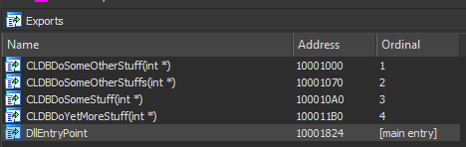
Export & Import relationship
We have seen imported functions inside LockDownBrowser.exe
What does the exported side look like in LockDownBrowser.dll?
LockDownBrowser.dll export table

Slide 15
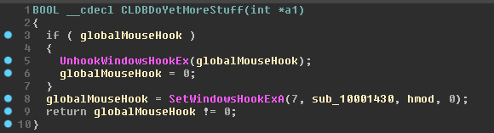
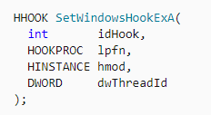
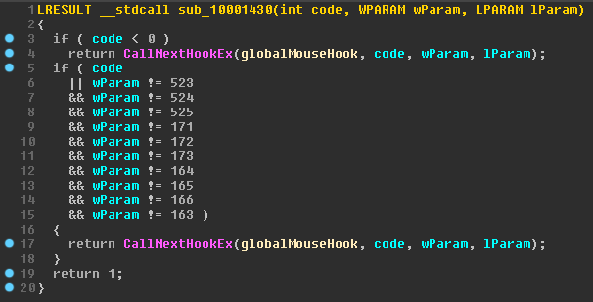
Comparing function disassembly
1

Slide 16
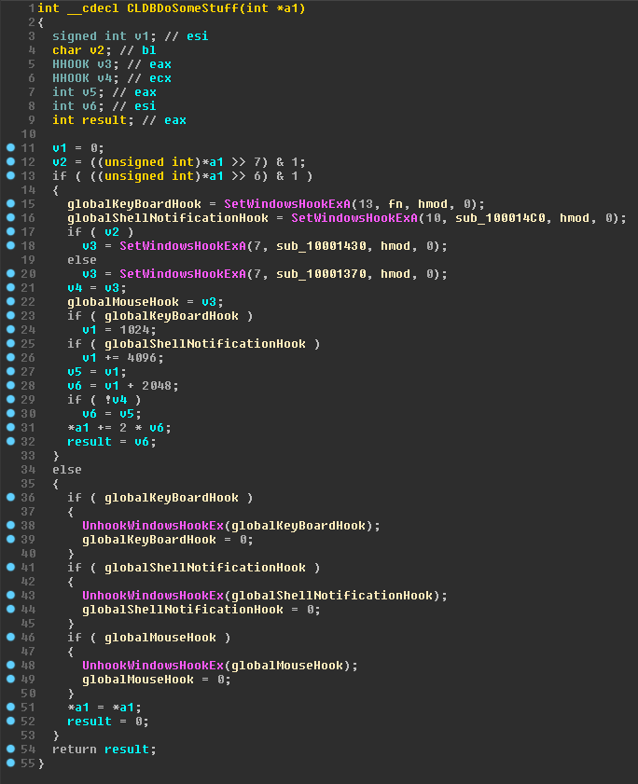
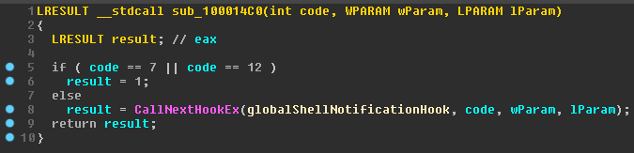
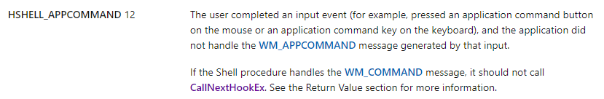
Comparing function disassembly
2

Slide 17
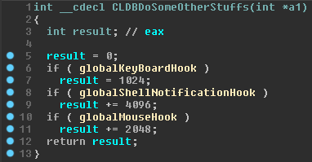
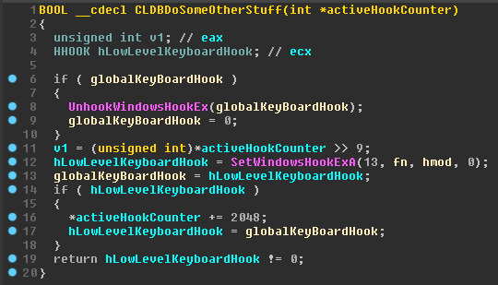
Comparing function disassembly
3

Slide 18
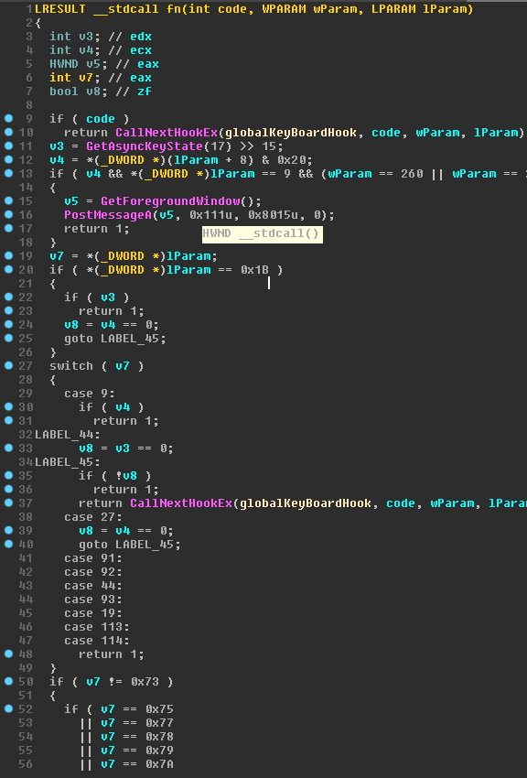
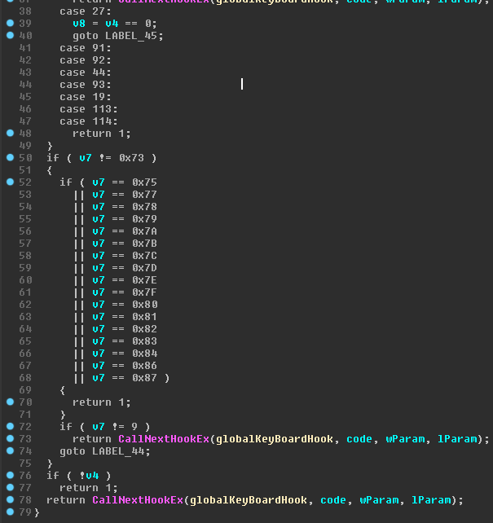
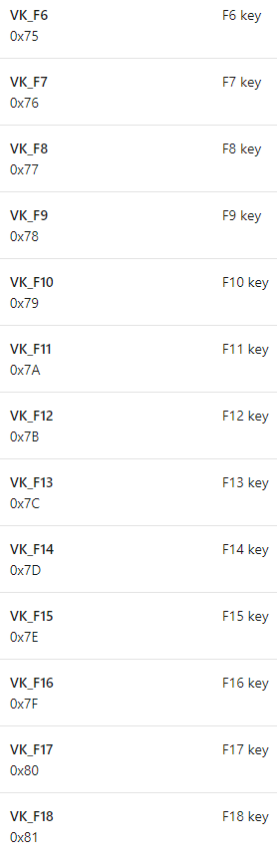

Slide 19
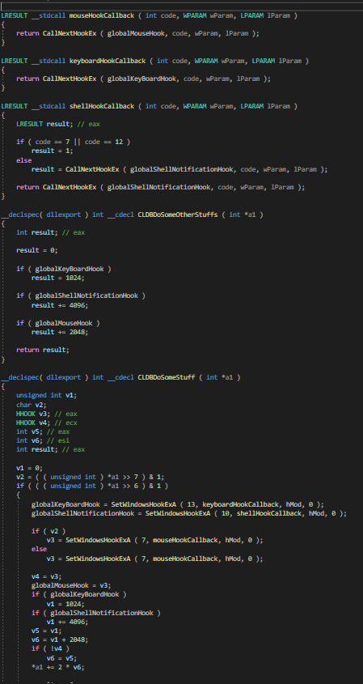
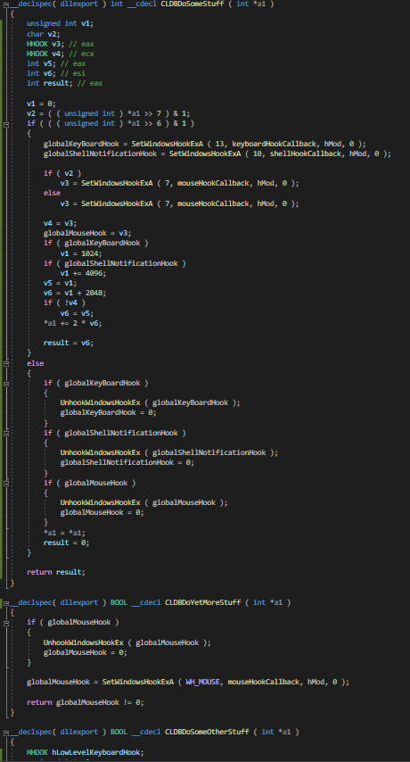
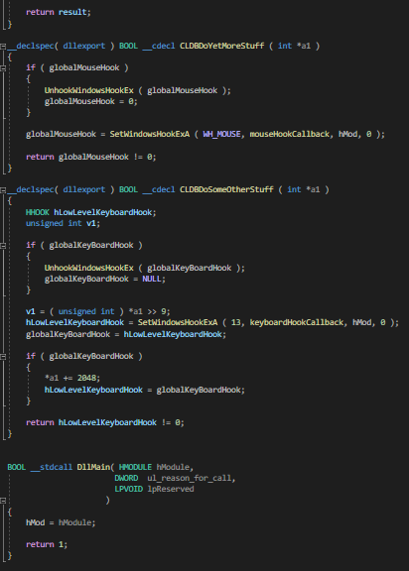
Let's get started

Slide 20
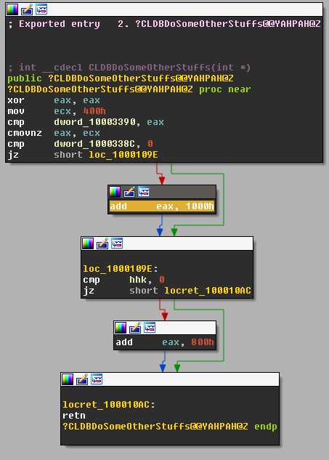
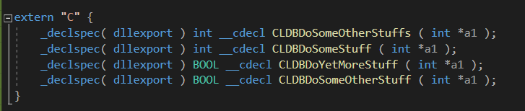
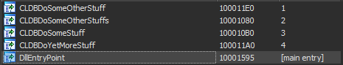
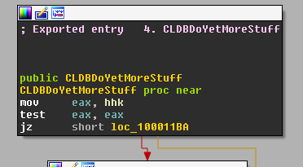
Finished writing module, now what?
Symbols look good!
One mistake to avoid:

Slide 21
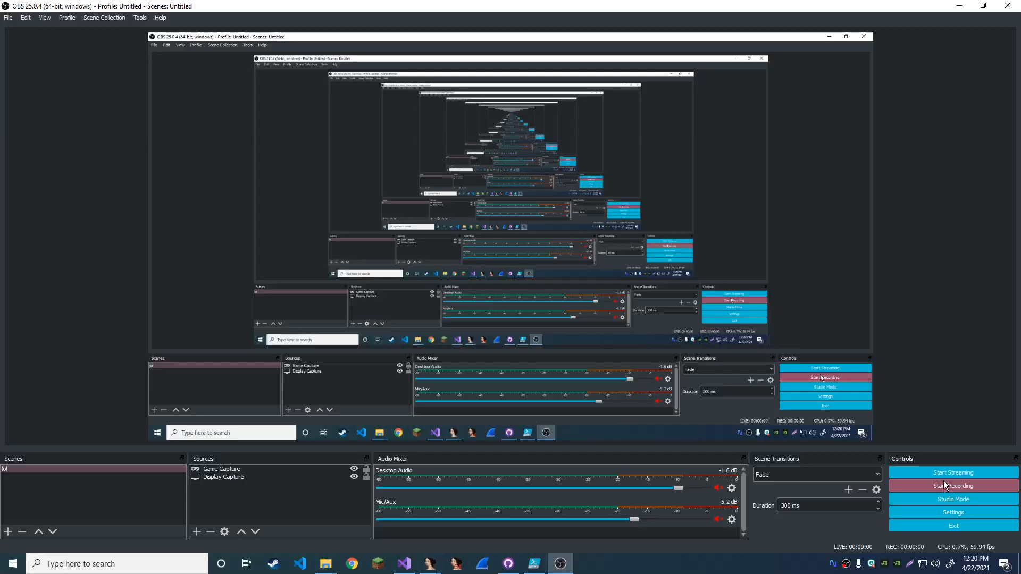
Demo – library module replacement

Slide 22
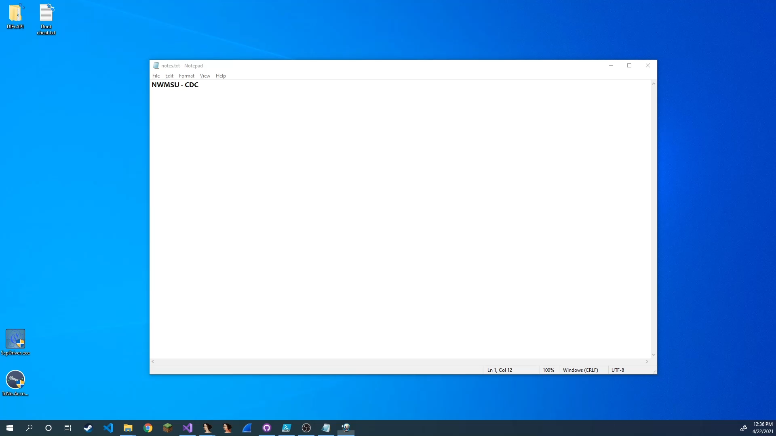
Demo – Regular process injection

Slide 23
practicality
In all honesty, this isn’t useful in the “real world”
However: Windows process injection should be studied further
Most importantly, I hope you learned something

Slide 24
Tools used
IDA Pro – Disassembly
Visual Studio 2019
Xenos Injector
..brain (all the 2 braincells left)

Slide 25
Questions?

